Slide 1
introducing This Is a Test OF Power Point 2010
a tour of new features
Notes:
This presentation demonstrates the new capabilities of PowerPoint and it is best viewed in Slide Show. These slides are designed to give you great ideas for the presentations you’ll create in PowerPoint 2010!
For more sample templates, click the File tab, and then on the New tab, click Sample Templates.

Slide 2



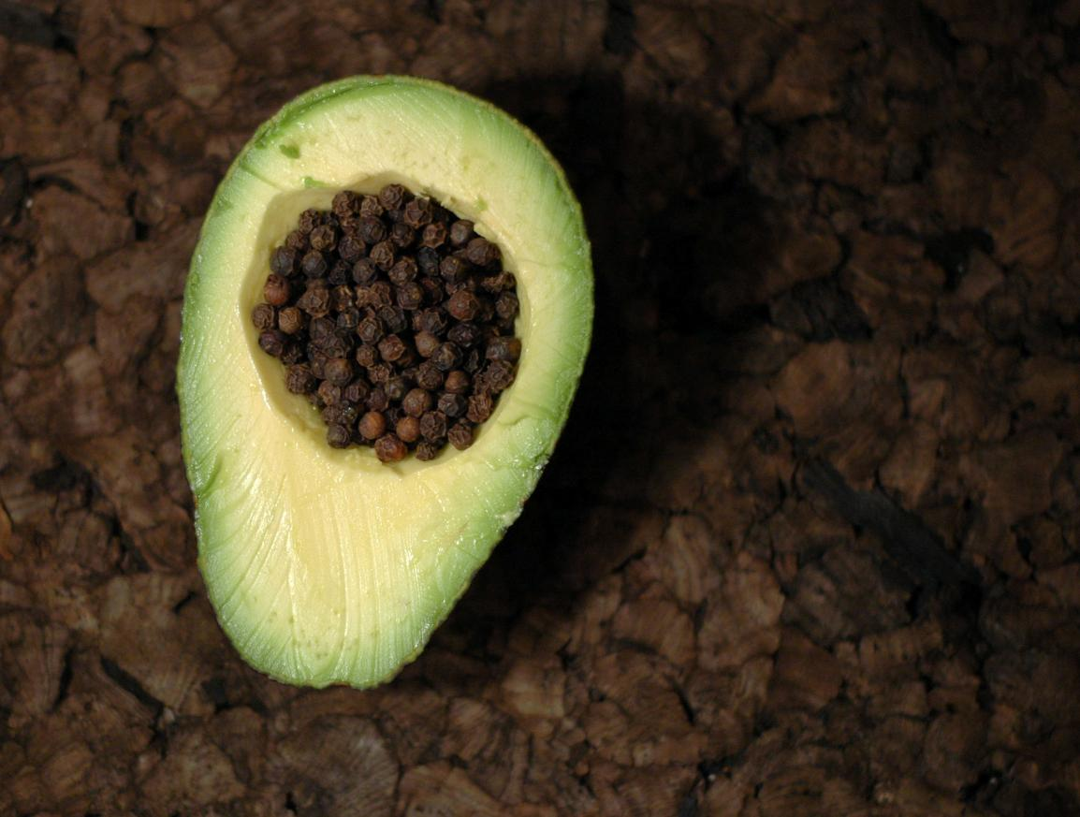
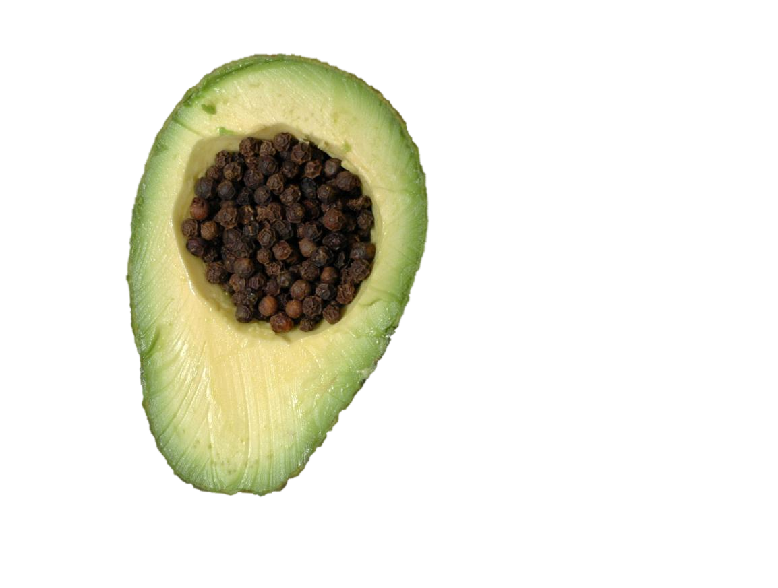
New Picture Effects
Picture Color, Corrections, Artistic Effects,
and Background Removal allow you to customize images for your story

Slide 3




Animate This
Check out this animation:
With the Animation Painter
you can re-create the same animation with one click

Slide 4



Video Perfect
You can do a lot more with videos in PowerPoint 2010.
Videos can be embedded in your presentation. That’s right, no more lost videos!
Also, you can recolor the entire video or apply a video style easily. Your videos will look great!

Slide 5
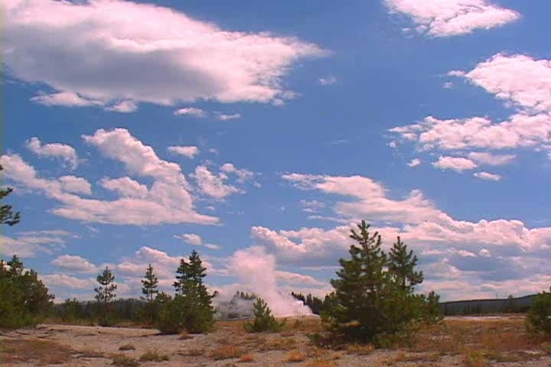
Fountain Geyser
Want to jump to a bookmark in your video? Hover over the video and you’ll be pleasantly surprised.
Did we mention you can add bookmarks, include fades, and trim your videos now?

